Slide 1
1
Business Processes and Business Process Management

Slide 2
Chapter Outline
Business Processes (BP)
Business Process Reengineering (BPR)
Business Process Improvement (BPI)
Business Process Management (BPM)
Discuss ways in which IS enable cross-functional BP and BP for a single functional area.
Compare and contrast BPR, BPI and BPM.

Slide 3
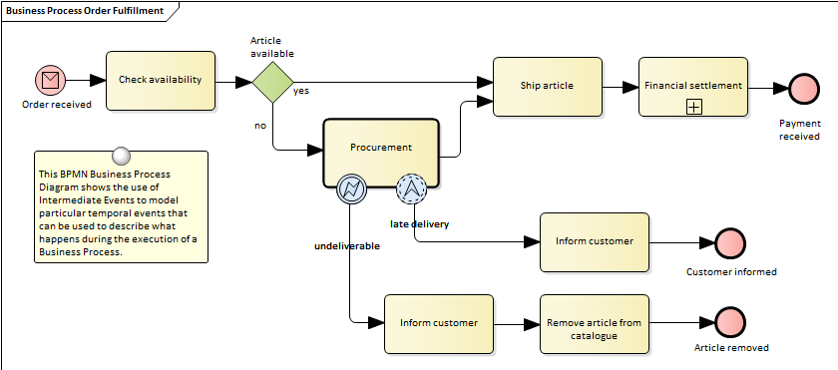
Business Processes: Inputs, Resources, and Outputs
2 Metrics of BP:
Efficiency: Doing things well
Effectiveness: Doing things that matter.
An ongoing collection of related activities that create a product or a service of value to the organization, its business partners, and/or its customers.
A YouTube Video: http://theprocessconsultant.com/business-process-and-it/
Notes:
Elements of BPs

Slide 4
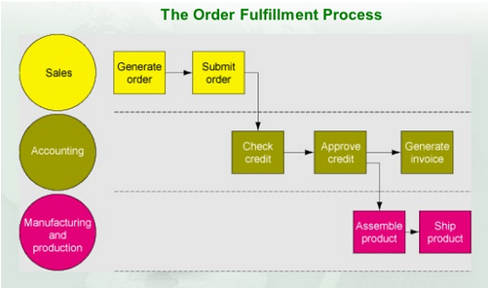
Cross-Functional Processes
Cut across multiple functional areas;
Multiple functional areas collaborate to perform the process;
No single functional area is responsible for their execution.
e.g., procurement and fulfillment.

Slide 5

IS enabled Business Processes
Information Systems (IS):
A critical enabler of business processes.
Facilitate communication and coordination among different functional areas.
Allow easy exchange of, and access to, data across processes.
IS’ vital role in 3 areas: Could be fully automated
Executing the process
Capturing and storing process data: e.g., RFID
Monitoring process performance
For example: e-commerce as a set of the Internet-enabled business processes: https://www.youtube.com/watch?v=AhgtoQIfuQ4

Slide 6

BP Reengineering (BPR)
A strategy for making an organization’s business processes more productive and profitable.
Examining business processes;
Determining how they can best reconstruct those processes to improve their business functions.
Difficult, radical, and comprehensive to do.

Slide 7

BP Improvement (BPI)
Focuses on reducing variation in the process outputs: Streamline your business
Searching for root causes of the variation in the process (such as a broken machine on an assembly line) or among the process inputs (such as a decline in the quality of raw materials purchased from a certain supplier).
Less radical; less disruptive; more incremental.

Slide 8
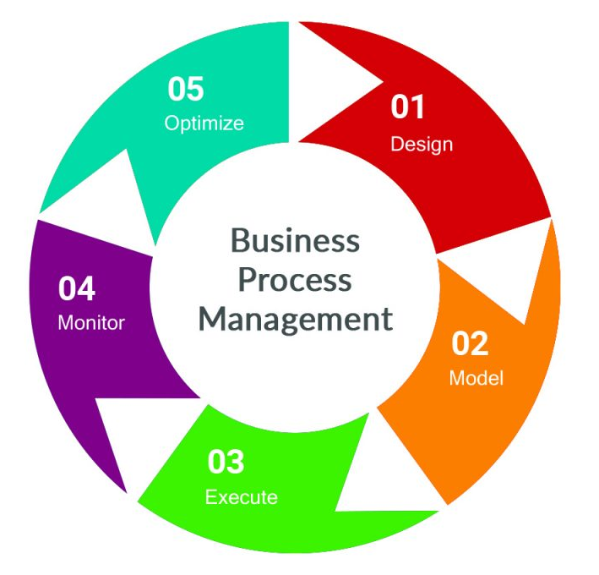
BP Management (BPM)
A management system designed to sustain BPI efforts over time;
Includes methods and tools to support the design, analysis, implementation, management, and continuous optimization of core BP throughout the organization;
Integrates disparate BPI initiatives to ensure consistent strategy execution.

Slide 9
’S ABOUT BUSINESS PI1.1
Chevron
  What was one of the main advantages of BPR at Chevron?
  Why did Chevron adopt BPI?
  How does Chevron apply BPM in its operations today?

Slide 10
Summary
Business Processes (BP)
Business Process Reengineering (BPR)
Business Process Improvement (BPI)
Business Process Management (BPM)
Discuss ways in which IS enable cross-functional BP and BP for a single functional area.
Compare and contrast BPR, BPI and BPM.

